Slide 1


Darío Espinoza
December 2024

Slide 2

Outline
Executive Summary
Introduction
Methodology
Results
Conclusion
Appendix

Slide 3
Executive Summary
Summary of methodologies
Data Collection through API
Data Collection with Web Scraping
Data Wrangling
Exploratory Data Analysis with SQL
Exploratory Data Analysis with Data Visualization
Interactive Visual Analytics with Folium
Machine Learning Prediction
Summary of all results
Exploratory Data Analysis result
Interactive analytics in screenshots
Predictive Analytics result

Slide 4
Introduction
Project background and context
At the end of this project, it is expected to have a predictive model that can help estimate the probability of a successful landing of the Falcon 9 first stage, thus providing valuable information for the aerospace industry and launch cost planning.
In order to predict the success of the landing of the Falcon 9 first stage, it is necessary to consider several factors that influence the landing outcome.
Problems you want to find answers
These factors can be classified into different categories, such as technical characteristics of the launch, environmental conditions, and operational data. Some of these factors include
- Launch Characteristics
- Environmental Conditions
- Operational Data
- Data Collection and Preprocessing
- Data Visualization
- Machine Learning
- Synthesis and Presentation

Slide 5

Section 1

Slide 6
Methodology
Executive Summary
Data collection methodology:
Describe how data was collected
Perform data wrangling
Describe how data was processed
Perform exploratory data analysis (EDA) using visualization and SQL
Perform interactive visual analytics using Folium and Plotly Dash
Perform predictive analysis using classification models
How to build, tune, evaluate classification models

Slide 7
Data Collection
Data was collected using methods
The data collection was a GET request to the SpaceX API.
We then decoded the response content as a JSON using the .json() function call and converted it to a pandas dataframe using .json_normalize().
We then cleaned the data, checked for missing values, and filled in missing values ​​where necessary.
Additionally, we performed a web scraping of Wikipedia for Falcon 9 launch logs using BeautifulSoup.
The goal was to extract the launch logs as an HTML table, parse the table, and convert it to a pandas dataframe for future analysis.

Slide 8
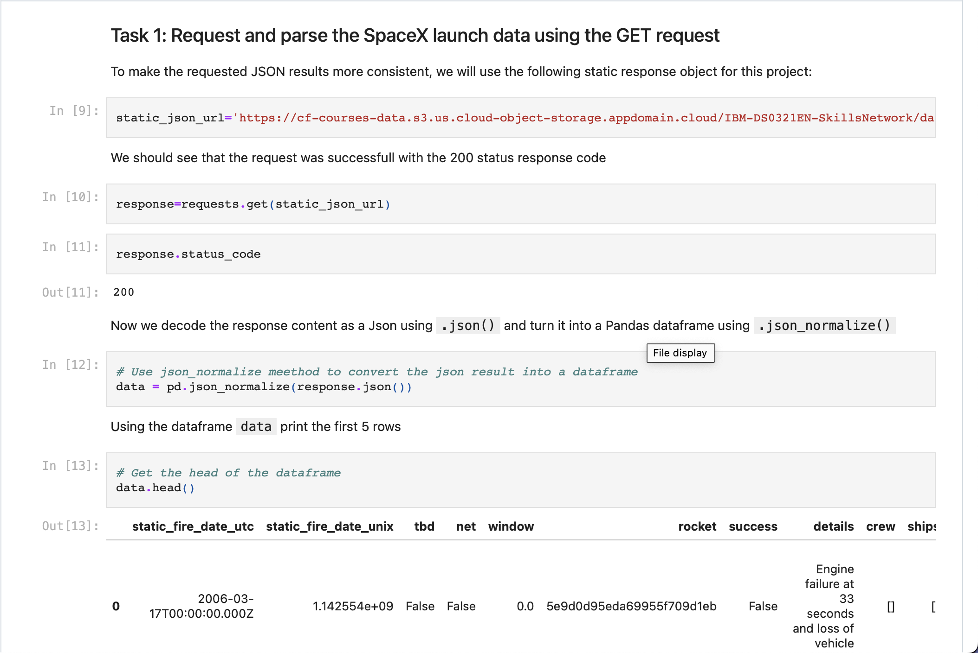
Data Collection – SpaceX API
Present your data collection with SpaceX REST calls using key phrases and flowcharts
Add the GitHub URL of the completed SpaceX API calls notebook (https://github.com/Dar2818io/1-notebook/blob/main/001spacex_data_collection_api.ipynb), as an external reference and peer-review purpose
Place your flowchart of SpaceX API calls here

Slide 9
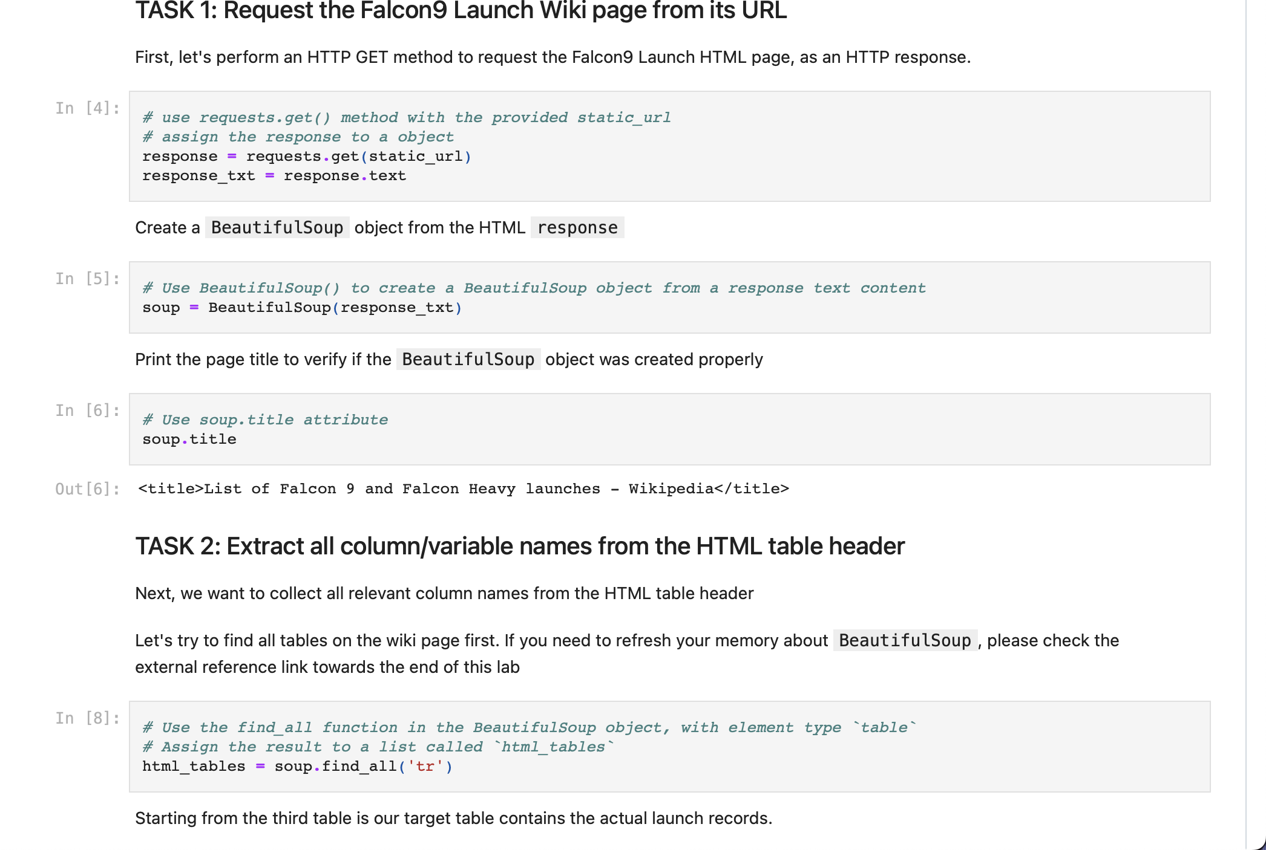
Data Collection - Scraping
Present your web scraping process using key phrases and flowcharts
Add the GitHub URL of the completed web scraping notebook, https://github.com/Dar2818io/1-notebook/blob/main/002webscraping.ipynb
Place your flowchart of web scraping here

Slide 10

Data Wrangling
Describe how data were processed
You need to present your data wrangling process using key phrases and flowcharts
Add the GitHub URL of your completed data wrangling related notebooks, as an external reference and peer-review purpose
https://github.com/Dar2818io/1-notebook/blob/main/003spacex_Data_wrangling.ipynb

Slide 11
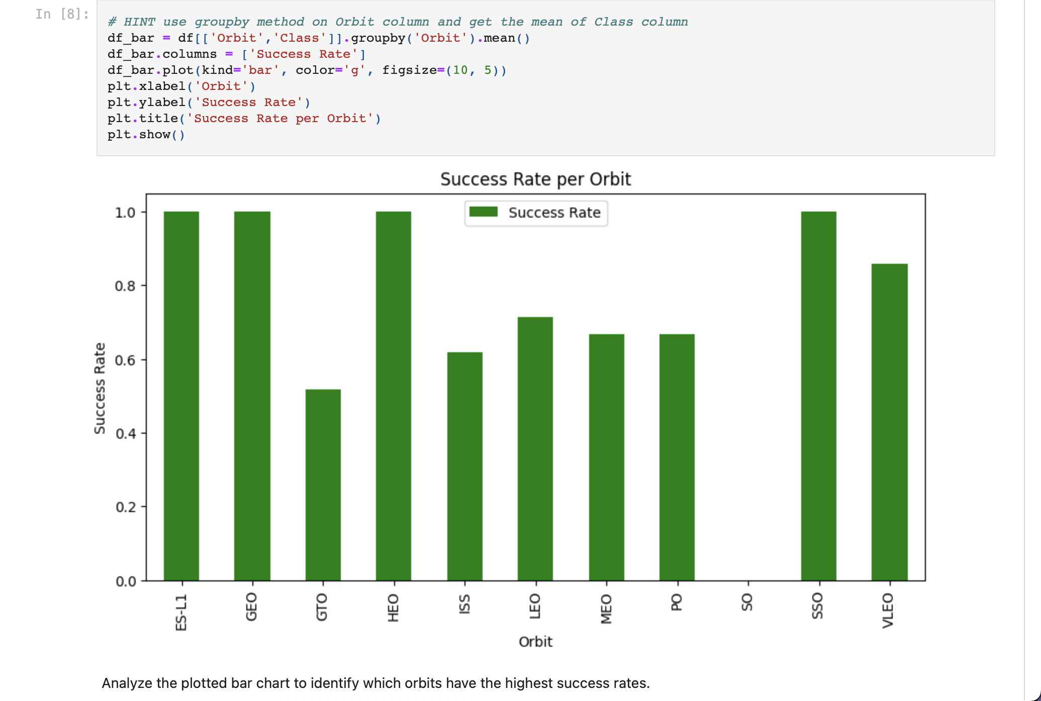
EDA with Data Visualization
Summarize what charts were plotted and why you used those charts
Add the GitHub URL of your completed EDA with data visualization notebook, as an external reference and peer-review purpose
https://github.com/Dar2818io/1-notebook/blob/main/005_edadataviz.ipynb

Slide 12
EDA with SQL
Using bullet point format, summarize the SQL queries you performed
The names of unique launch sites in the space mission.
The total payload mass carried by boosters launched by NASA (CRS)
The average payload mass carried by booster version F9 v1.1
The total number of successful and failure mission outcomes
The failed landing outcomes in drone ship, their booster version and launch site names.
Add the GitHub URL of your completed EDA with SQL notebook, as an external reference and peer-review purpose
https://github.com/Dar2818io/1-notebook/blob/main/004eda-sql-coursera_sqllite.ipynb

Slide 13
Build an Interactive Map with Folium
We marked all launch sites, and added map objects such as markers, circles, lines to mark the success or failure of launches for each site on the folium map.
We assigned the feature launch outcomes (failure or success) to class 0 and 1.i.e., 0 for failure, and 1 for success.
Using the color-labeled marker clusters, we identified which launch sites have relatively high success rate.
We calculated the distances between a launch site to its proximities. We answered some question for instance:

Slide 14
Build a Dashboard with Plotly Dash
Summarize what plots/graphs and interactions you have added to a dashboard
Explain why you added those plots and interactions
Add the GitHub URL of your completed Plotly Dash lab, as an external reference and peer-review purpose
https://github.com/Dar2818io/1-notebook/blob/main/Plotly.py

Slide 15
Predictive Analysis (Classification)
We loaded the data using numpy and pandas, transformed the data, split our data into training and testing.
We built different machine learning models and tune different hyperparameters using GridSearchCV.
We used accuracy as the metric for our model, improved the model using feature engineering and algorithm tuning.
We found the best performing classification model.
Add the GitHub URL of your completed predictive analysis lab, as an external reference and peer-review purpose
https://github.com/Dar2818io/1-notebook/blob/main/008_SpaceX_Machine_Learning_Prediction_Part_5.ipynb

Slide 16
Results
Exploratory data analysis results
Interactive analytics demo in screenshots
Predictive analysis results

Slide 17

Section 2

Slide 18

Flight Number vs. Launch Site
From the plot, we found that the larger the flight amount at a launch site, the greater the success rate at a launch site.

Slide 19
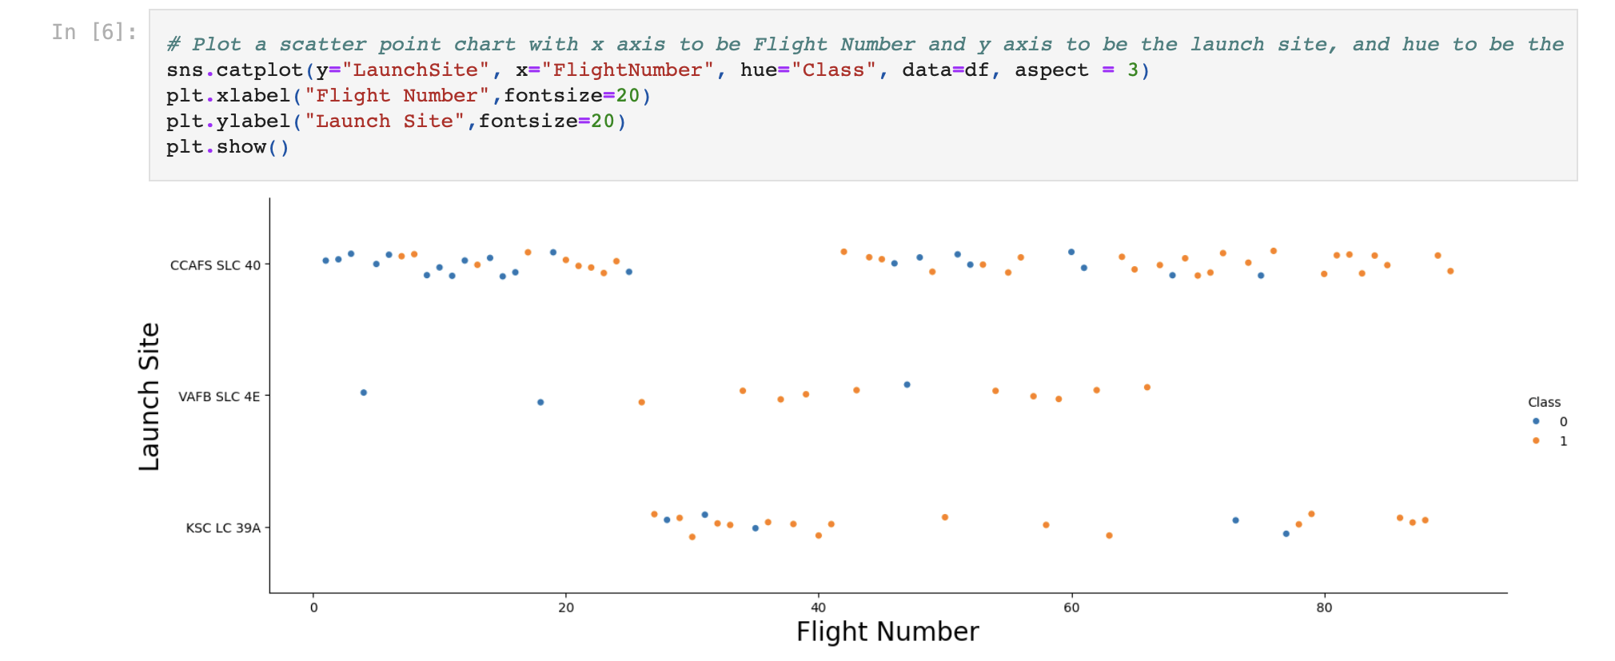
Payload vs. Launch Site

Slide 20
Success Rate vs. Orbit Type
From the plot, we can see that ES-L1, GEO, HEO, SSO, VLEO had the most success rate.

Slide 21
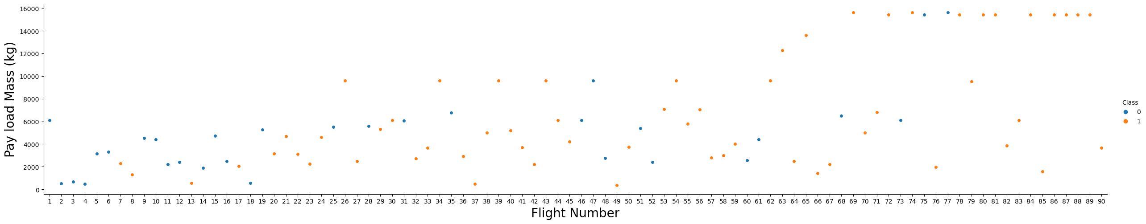
Flight Number vs. Orbit Type
The plot below shows the Flight Number vs. Orbit type. We observe that in the LEO orbit, success is related to the number of flights whereas in the GTO orbit, there is no relationship between flight number and the orbit.

Slide 22
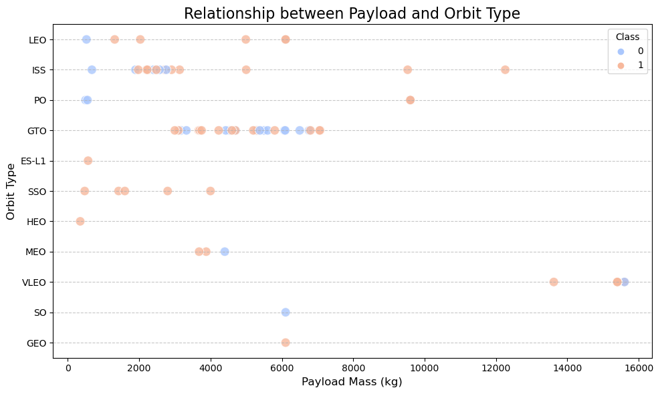
Payload vs. Orbit Type
We can observe that with heavy payloads, the successful landing are more for PO, LEO and ISS orbits.

Slide 23
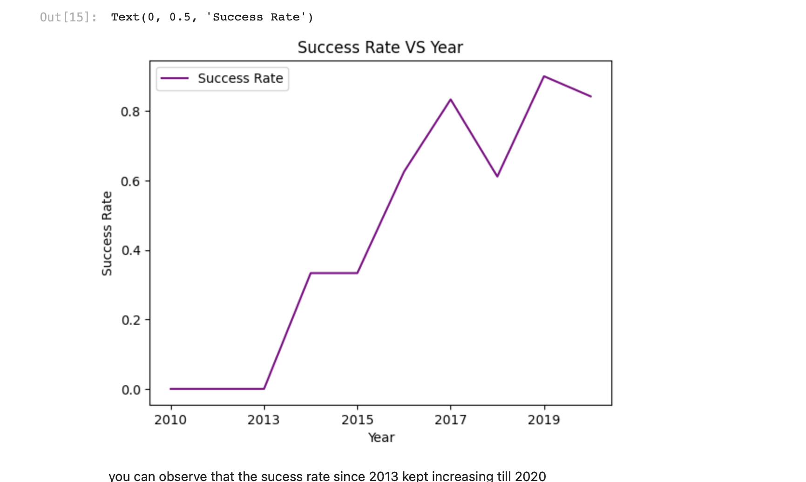
Launch Success Yearly Trend
From the plot, we can observe that success rate since 2013 kept on increasing till 2020.

Slide 24

All Launch Site Names
We used the key word DISTINCT to show only unique launch sites from the SpaceX data.

Slide 25

Launch Site Names Begin with 'CCA'
We used the query above to display 5 records where launch sites begin with `CCA`

Slide 26

Total Payload Mass
We calculated the total payload carried by boosters from NASA as 45596 using the query below

Slide 27
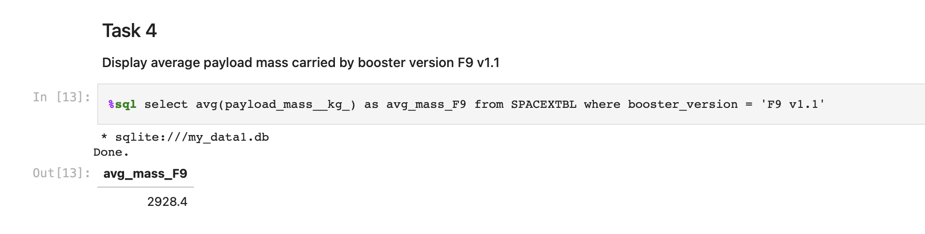
Average Payload Mass by F9 v1.1
We calculated the average payload mass carried by booster version F9 v1.1 as 2928.4

Slide 28
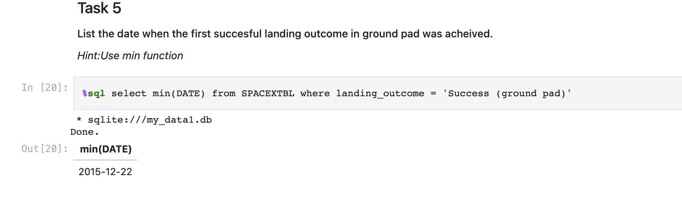
First Successful Ground Landing Date
We observed that the dates of the first successful landing outcome on ground pad was 22nd December 2015

Slide 29
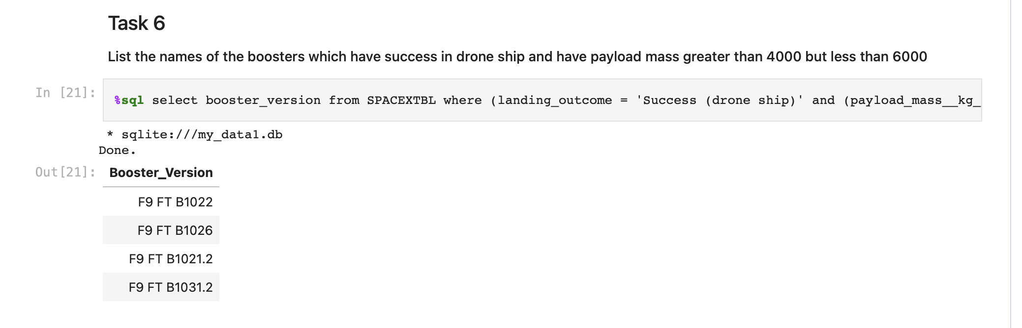
Successful Drone Ship Landing with Payload between 4000 and 6000
We used the WHERE clause to filter for boosters which have successfully landed on drone ship and applied the AND condition to determine successful landing with payload mass greater than 4000 but less than 6000

Slide 30
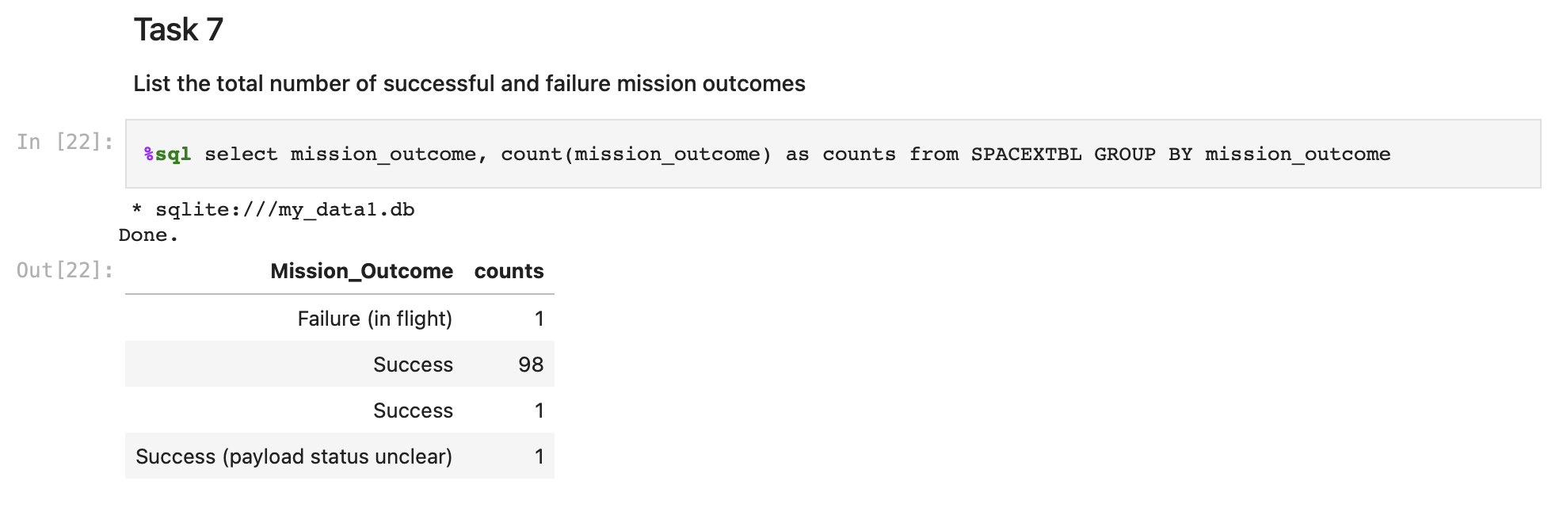
Total Number of Successful and Failure Mission Outcomes
We used wildcard like ‘%’ to filter for WHERE MissionOutcome was a success or a failure.

Slide 31
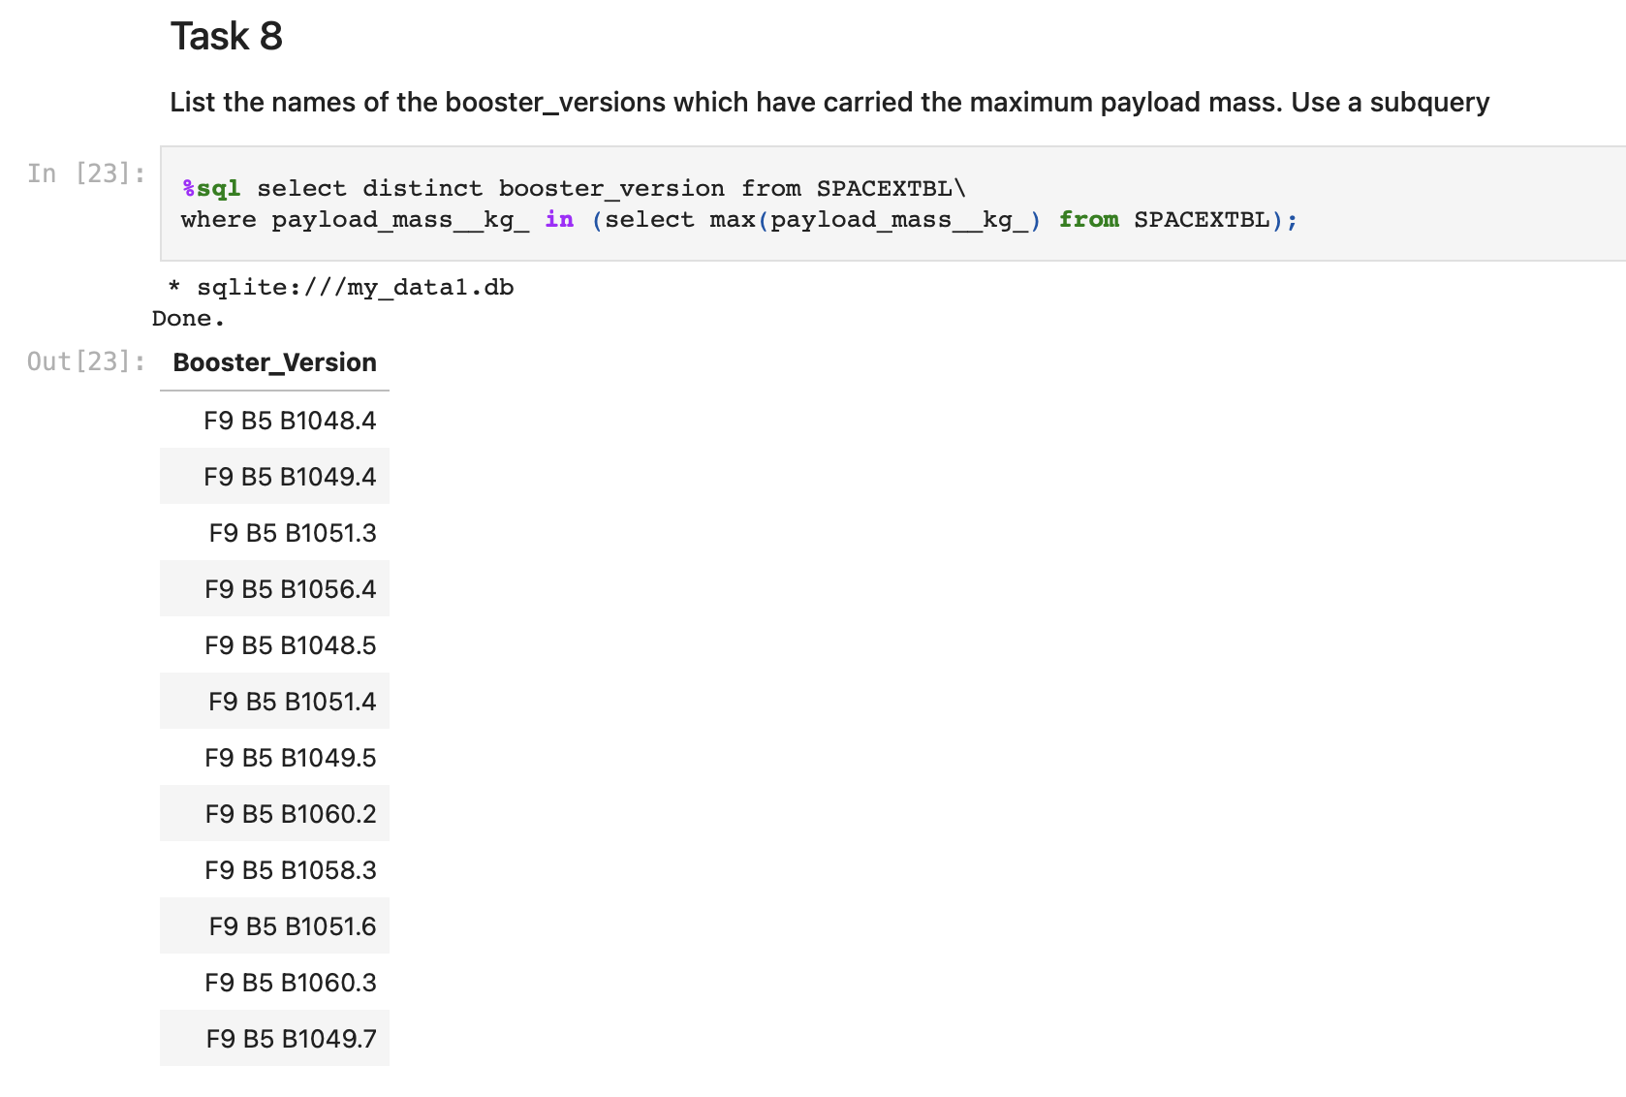
Boosters Carried Maximum Payload
We determined the booster that have carried the maximum payload using a subquery in the WHERE clause and the MAX() function.

Slide 32
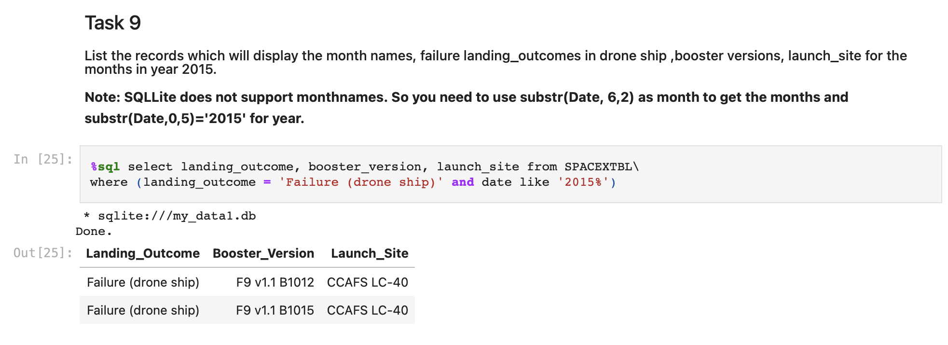
2015 Launch Records
We used a combinations of the WHERE clause, LIKE, AND, and BETWEEN conditions to filter for failed landing outcomes in drone ship, their booster versions, and launch site names for year 2015

Slide 33
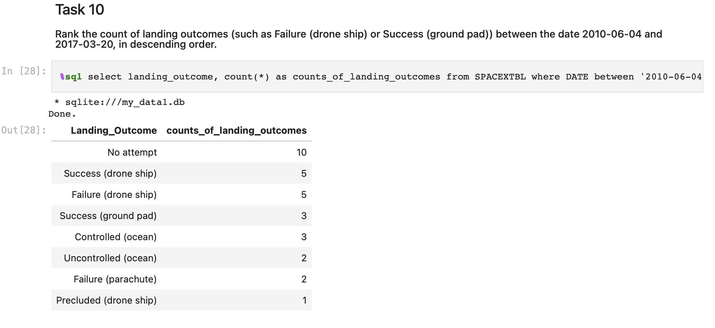
Rank Landing Outcomes Between 2010-06-04 and 2017-03-20
We selected Landing outcomes and the COUNT of landing outcomes from the data and used the WHERE clause to filter for landing outcomes BETWEEN 2010-06-04 to 2010-03-20.
We applied the GROUP BY clause to group the landing outcomes and the ORDER BY clause to order the grouped landing outcome in descending order.

Slide 34

Section 3

Slide 35

All launch sites global map markers
Replace <Folium map screenshot 1> title with an appropriate title
Explore the generated folium map and make a proper screenshot to include all launch sites’ location markers on a global map
Explain the important elements and findings on the screenshot

Slide 36

Markers showing launch sites with color labels

Slide 37

Launch Site distance to landmarks

Slide 38

Section 4

Slide 39

Pie chart showing the success percentage achieved by each launch site
Replace <Dashboard screenshot 1> title with an appropriate title
Show the screenshot of launch success count for all sites, in a piechart
Explain the important elements and findings on the screenshot

Slide 40

Pie chart showing the Launch site with the highest launch success ratio

Slide 41

Scatter plot of Payload vs Launch Outcome for all sites, with different payload selected in the range slider

Slide 42

Section 5

Slide 43

Classification Accuracy

Slide 44

Confusion Matrix
The confusion matrix for the decision tree classifier shows that the classifier can distinguish between the different classes. The major problem is the false positives .i.e., unsuccessful landing marked as successful landing by the classifier.

Slide 45
Conclusions
We can conclude that:
The larger the flight amount at a launch site, the greater the success rate at a launch site.
Launch success rate started to increase in 2013 till 2020.
Orbits ES-L1, GEO, HEO, SSO, VLEO had the most success rate.
KSC LC-39A had the most successful launches of any sites.
The Decision tree classifier is the best machine learning algorithm for this task.

Slide 46


